Slide 1
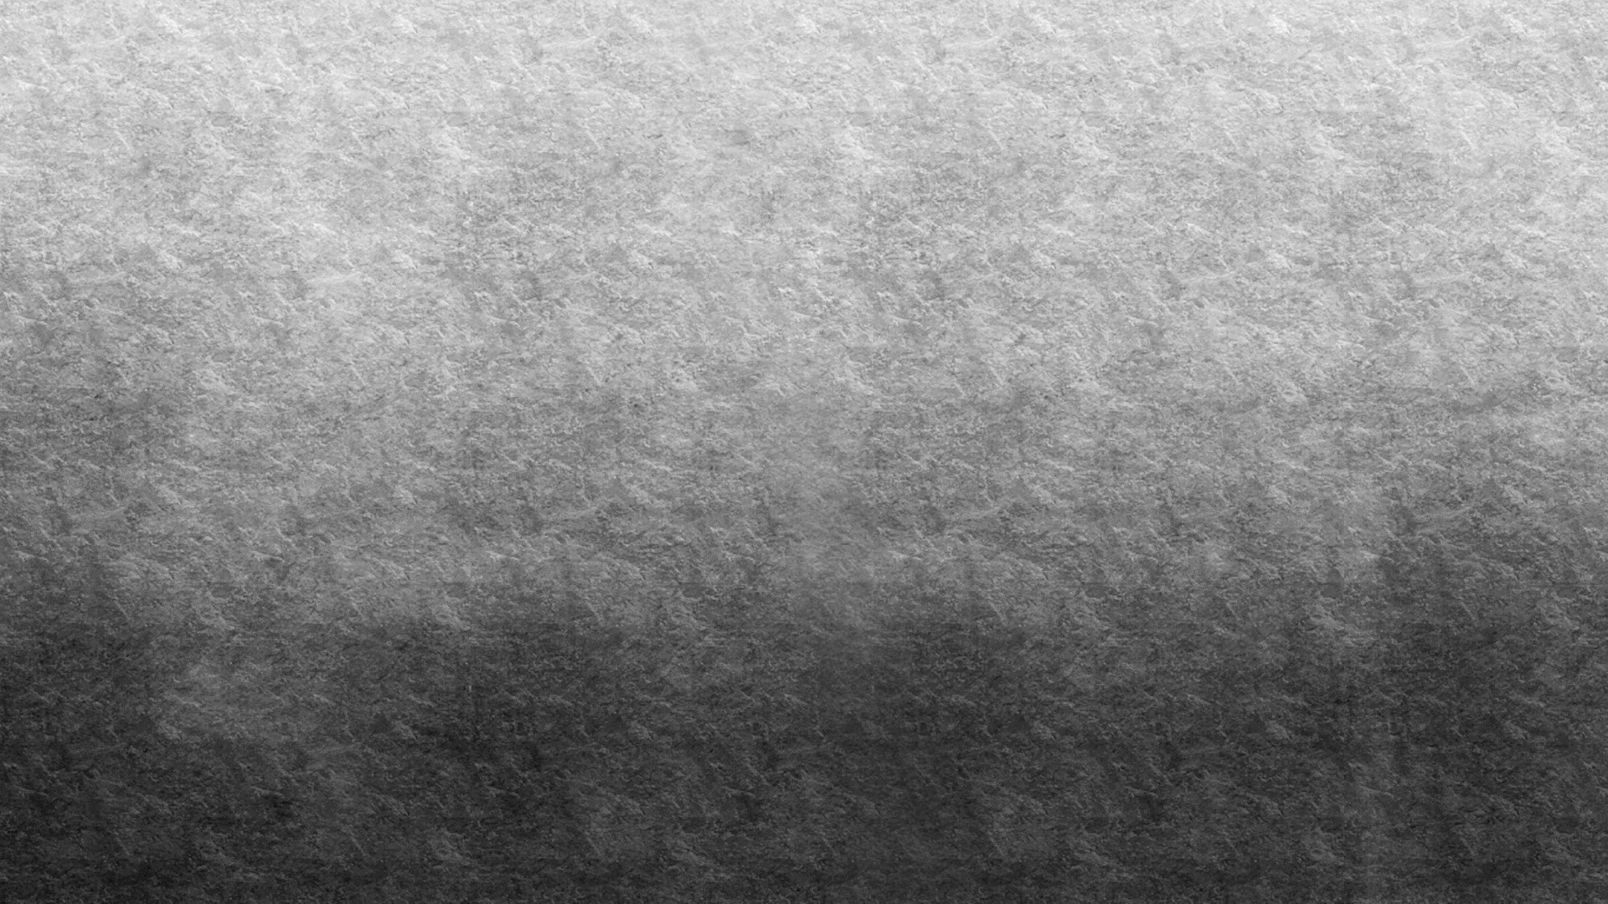
VFX Final Project DeepVo
李佳蓮
李尚倫
陳健倫

Slide 2
Outline
SFM SLAM->VO
Method of tradition vs. deep
Model
KITTI
Result gif on KITTI
Self made dataset through Blender
Result video on NTU

Slide 3
SFM SLAM -> VO

Slide 4
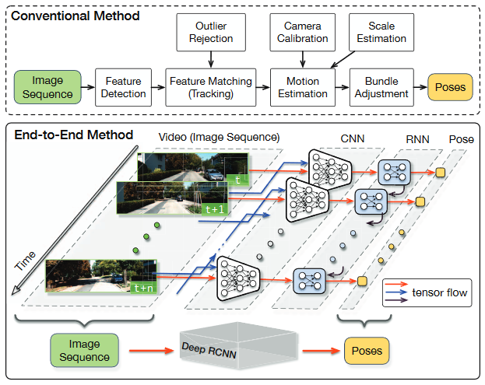
Method of tradition vs. deep

Slide 5
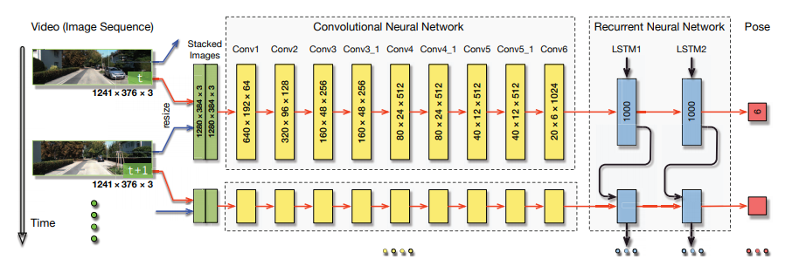
DeepVo Model

Slide 6
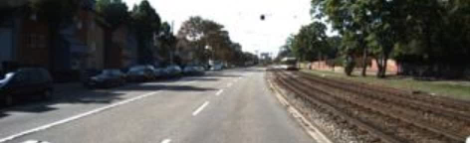
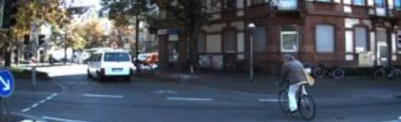
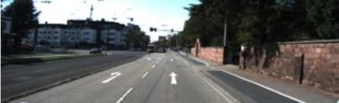
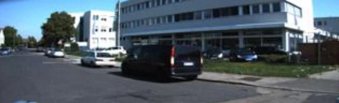
KITTI Dataset
0001
0005
0002
0009

Slide 7
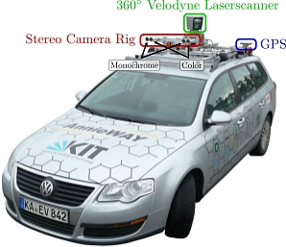
KITTI Dataset

Slide 8
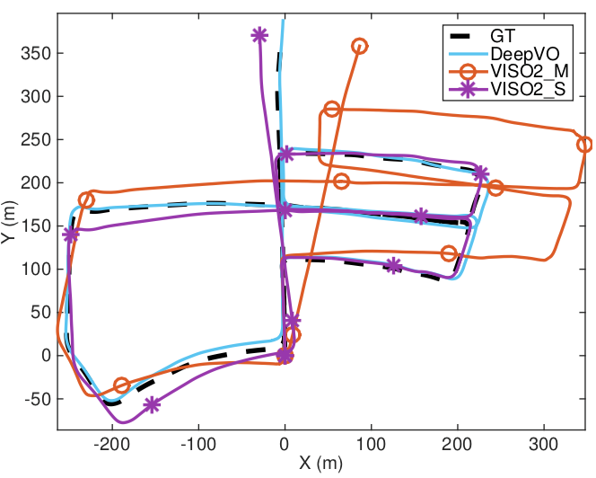
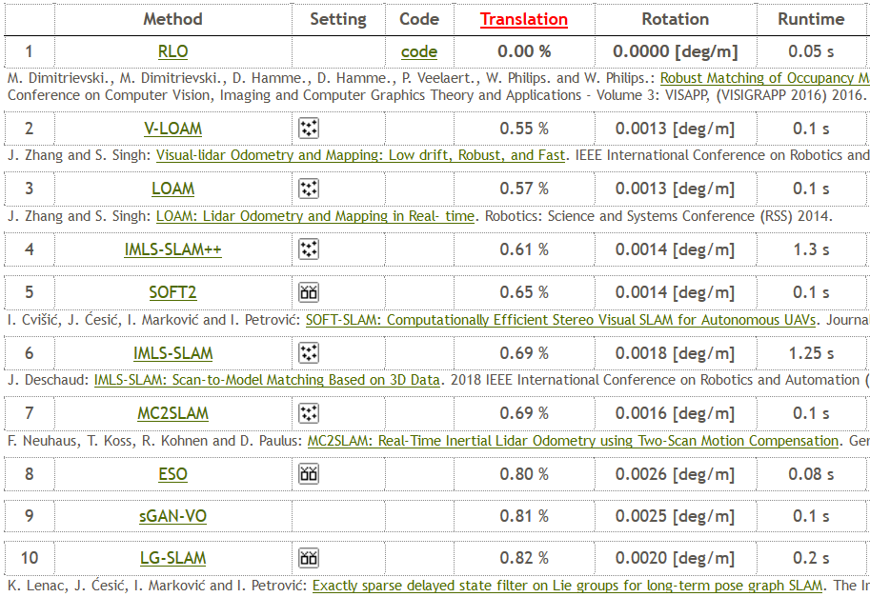
Odometry

Slide 9
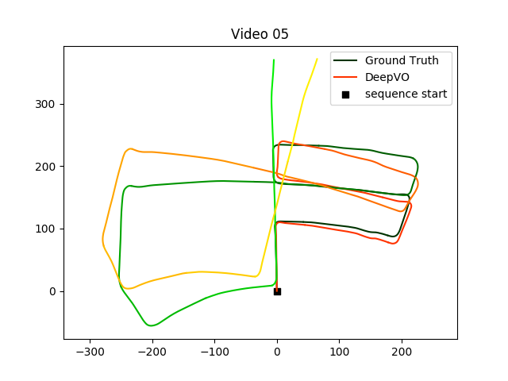
Result on KITTI (movie)

Slide 10
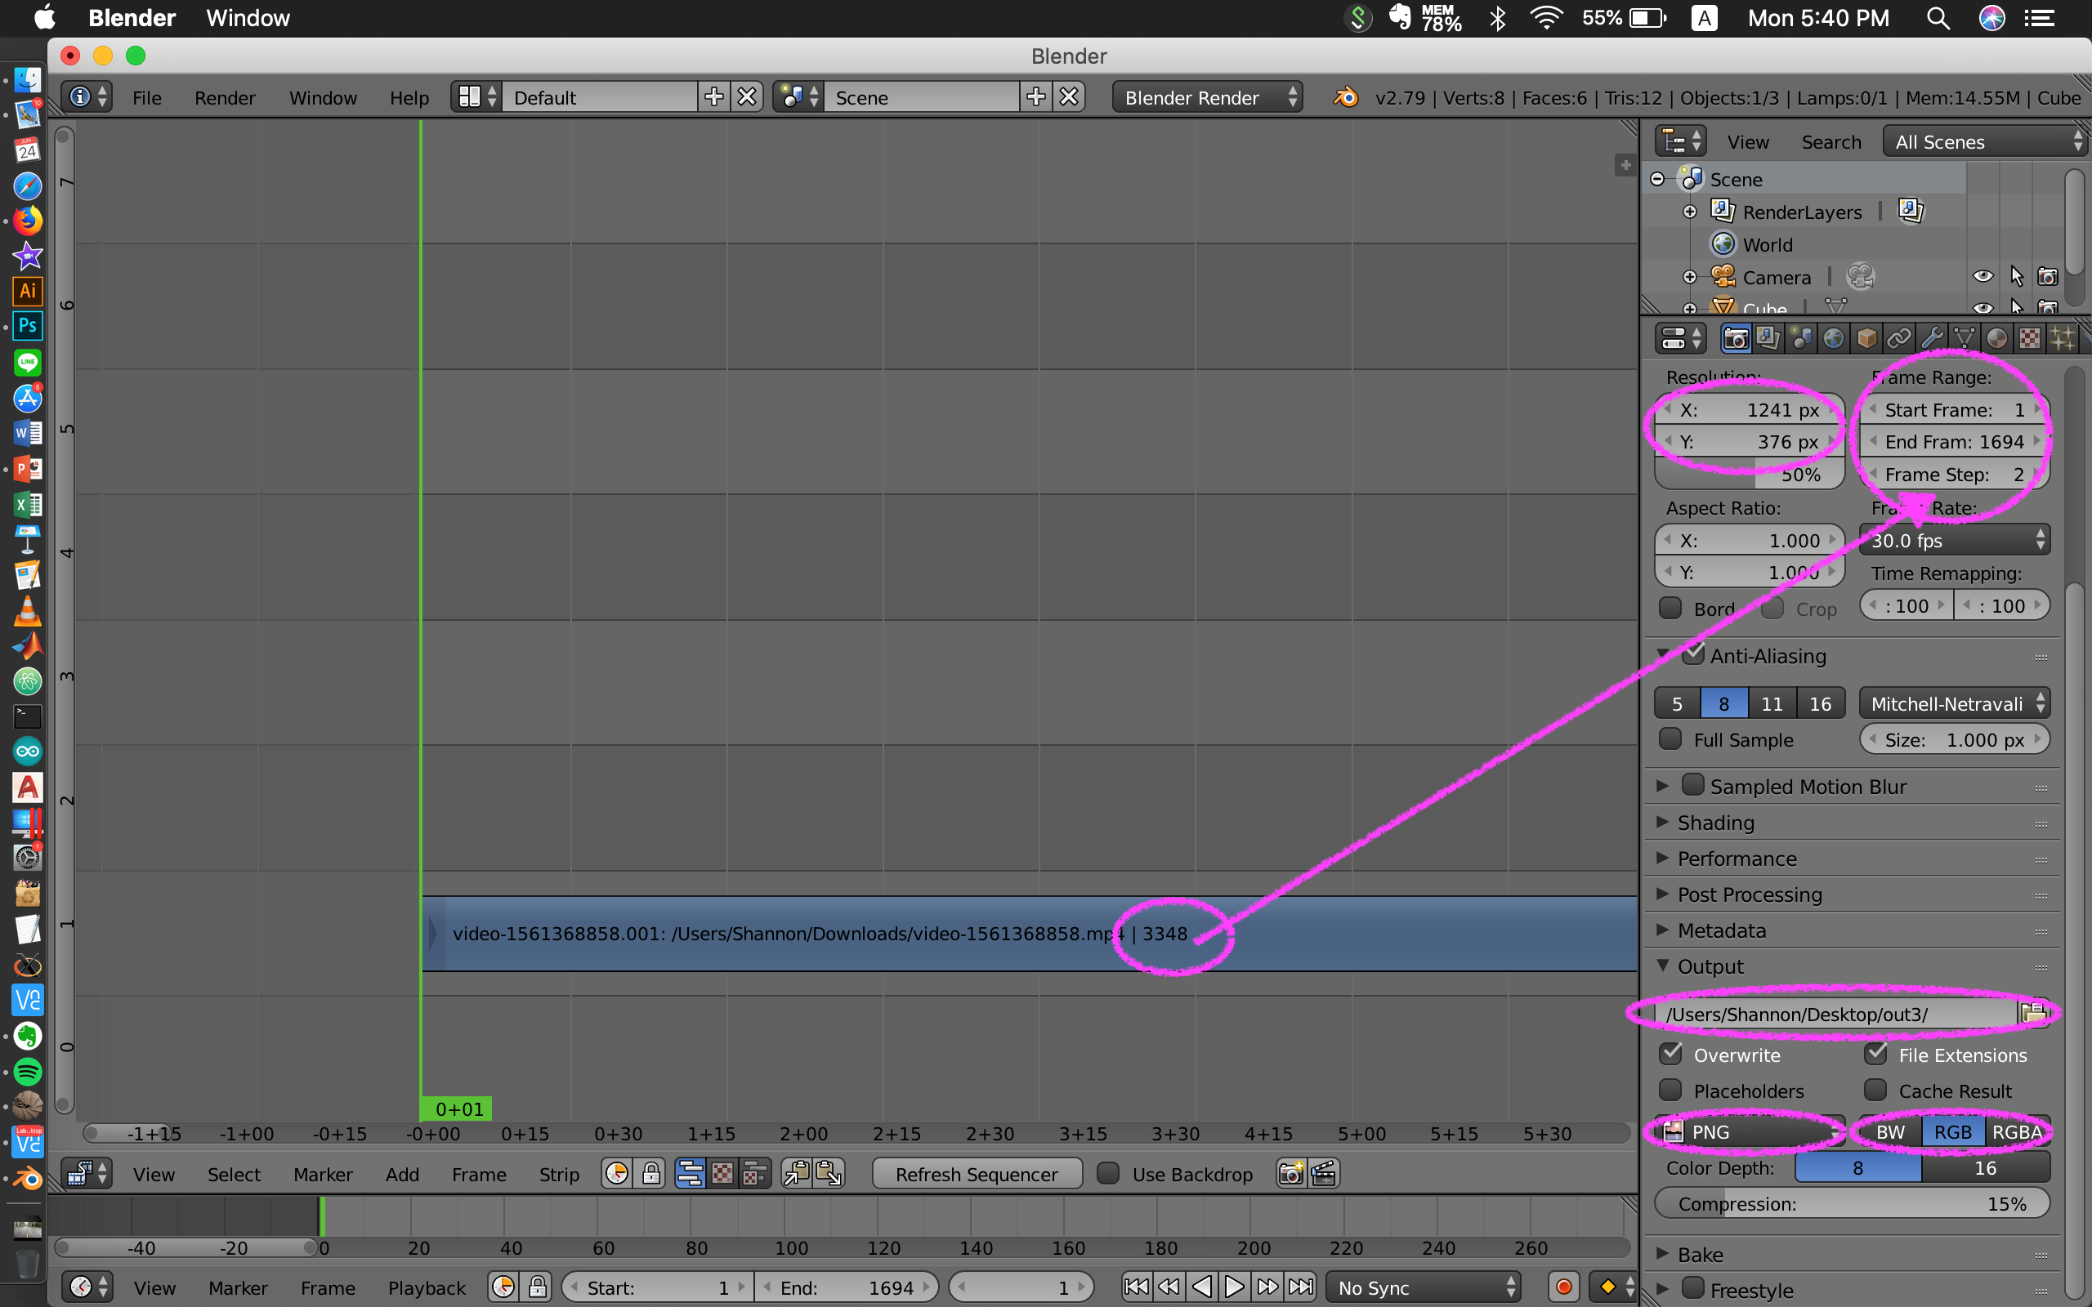
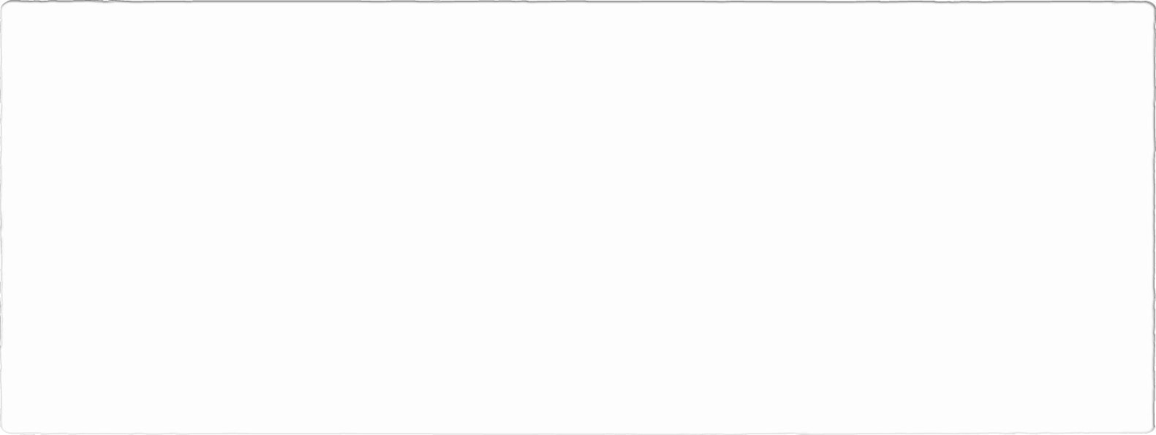
Self made dataset through Blender

Slide 11
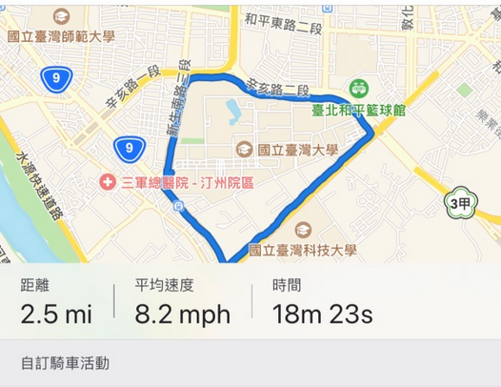
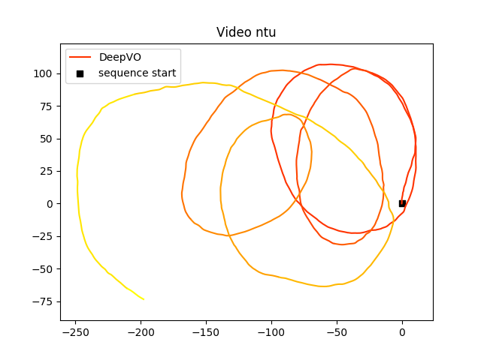
Result on NTU

